Slide 1
MSSP 608: Practical Machine Learning Methods Week 2
1

Slide 2
Review
2

Slide 3
Machine Learning Categories
Supervised Learning
Feature vs. Label relationship?
Learning with labeled data
Unsupervised Learning
No labels
Learning with unlabeled data
Reinforcement Learning
Positive vs. negative feedback

Slide 4
Real-world ML Process
System Objective: What problem will my system solve? What is the target deployment scenario? What are the performance objectives?
Approach: What is my solution and its components?
Data Collection
Identifying the data sources: What are my data sources ?
Collecting the data
Data Preparation
Preparing the data: Is my data business ready?
Ingesting the data: What is the right storage for my data
Model Development
Data preprocessing
Identification and training
Model evaluation
Hyperparameter Tuning
Model Deployment
Model optimization (if needed) for the deployment infrastructure
Model packaging and deployment
Monitoring and Feedback
Is my deployed model performing as expected?
Is there a drift in model performance which requires re-training?

Slide 5
Objectives
Decision trees
Rule-based Models
Information theory
Entropy; information gain; Gini index
Bias vs. variance trade off

Slide 6
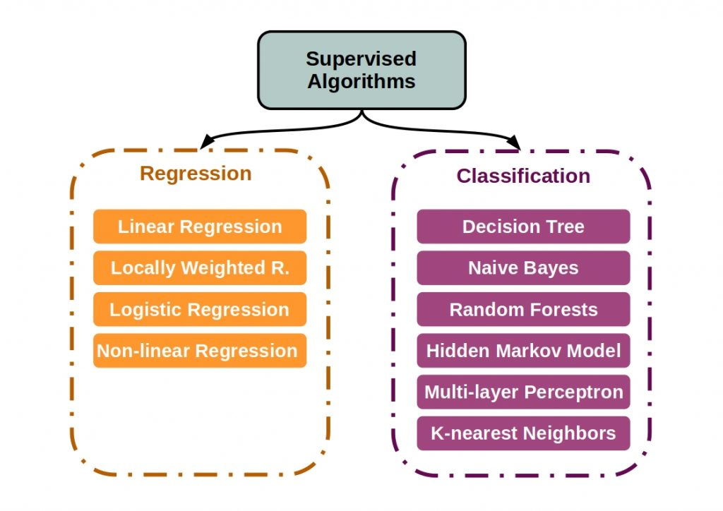
Supervised Learning

Slide 7
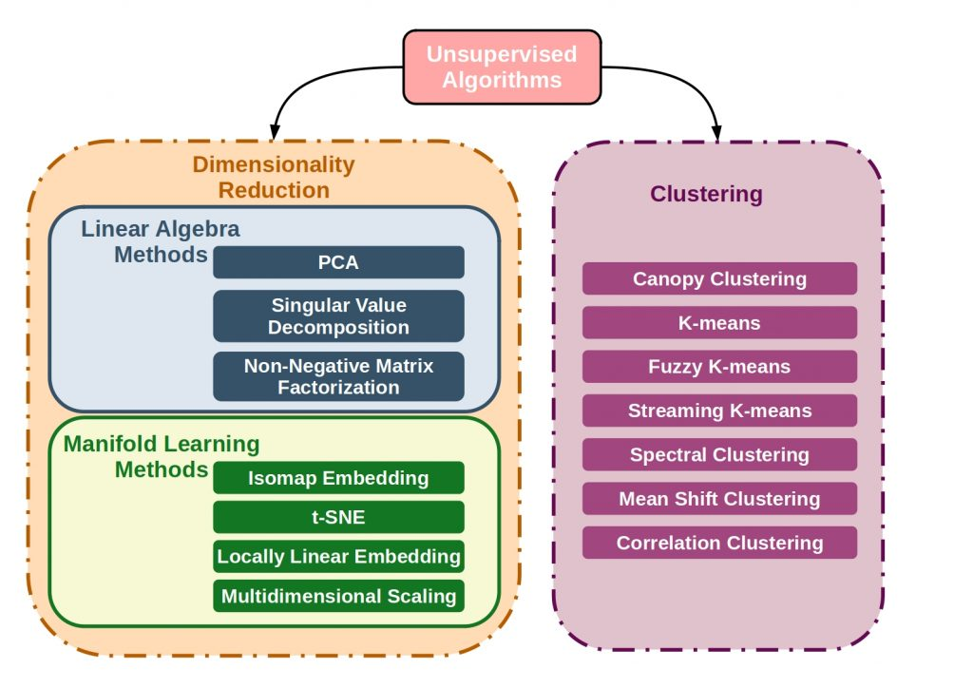
Unsupervised Learning

Slide 8
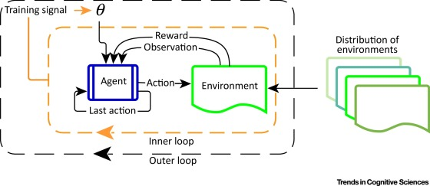
Reinforcement Learning

Slide 9
Research Example
9

Slide 10
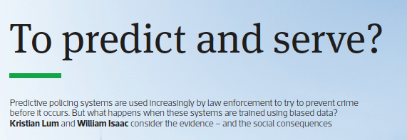
What is predictive policing?
Application of predictive analytics to determine how to allocate police across a city in order to best prevent crime.
Commonly used algorithms: PredPol, Palantir, HunchLabs, and IBM
What data is fed into the algorithm to predict drug crime?
Historical crime data
What happens when Black/LatinX communities are policed at higher rate than other communities?
Data will reflect higher drug crimes in Black/LatinX communities vs. other communities
Drug crime arrests does not reflect ACTUAL drug use

Slide 11
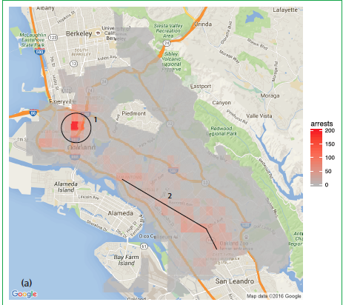
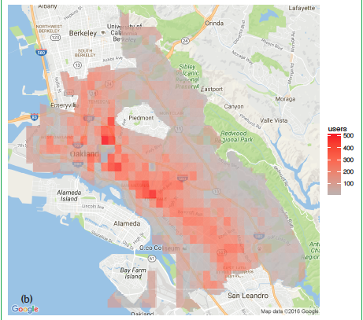
The problem resides in the data, not the algorithm…
The algorithms are behaving exactly as expected – they reproduce the patterns in the data used to train them…
What do we do???
Use different data resources
One solution was to combine a demographically representative synthetic population of Oakland, California with survey data from the 2011 National Survey on Drug Use and Health (NSDUH).
NSDUH is a nationally representative sample of individuals reporting drug use
Oakland, CA
Crime Data Drug Use Data

Slide 12
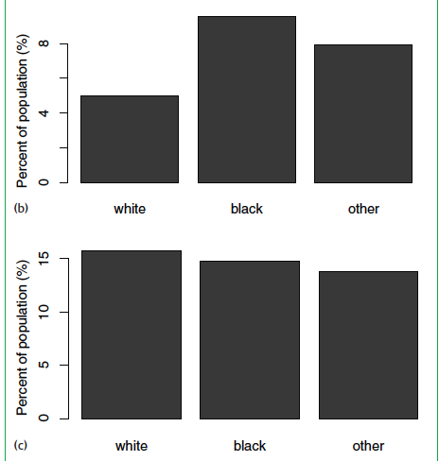
The problem resides in the data, not the algorithm…
Percentage of the population experiencing targeted policing for drug crimes broken down by race.
Using PredPol, black people would be targeted by predictive policing at roughly twice the rate of whites. Individuals classified as a race other than white or black would receive targeted policing at a rate 1.5 times that of whites
Estimated pattern of drug use by race, where drug use is roughly equivalent across racial classifications.

Slide 13
Implications
Predictive policing is reproducing, and magnifying police bias
Filters decision-making process through sophisticated software that few people understand
Lends unwarranted legitimacy to biased policing strategies.
“Garbage in, garbage out”

Slide 14
Decision Trees
14

Slide 15
What are Decision Trees?
https://chirag-sehra.medium.com/decision-trees-explained-easily-28f23241248
https://medium.com/aiguys/decision-tree-theory-explained-ddcfdba4e7df
https://www.careerlauncher.com/machine-learning/internship/bias-variance-in-machine-learning.html
https://www.valueinhealthjournal.com/article/S1098-3015(19)30146-9/fulltext
***PLEASE READ BEFORE CLASS***

Slide 16
Why Decision Trees?
Why choose decision tree over the multitude of other algorithms?
Decision trees are very efficient and can model very complex scenarios
They are fast to produce results
Biggest of all, they are the most interpretable algorithm in AI
The decision tree’s results can be easily understood

Slide 17
Decision Trees:
Decision tree builds classification or regression models in the form of a tree structure.
It breaks down a data set into smaller and smaller subsets while at the same time an associated decision tree is incrementally developed.
The result is a tree with decision nodes and leaf nodes.
A decision node has two or more branches.
Leaf node represents a classification or decision.
The topmost decision node in a tree which corresponds to the best predictor called root node.
Decision trees can handle both categorical and numerical data.

Slide 18
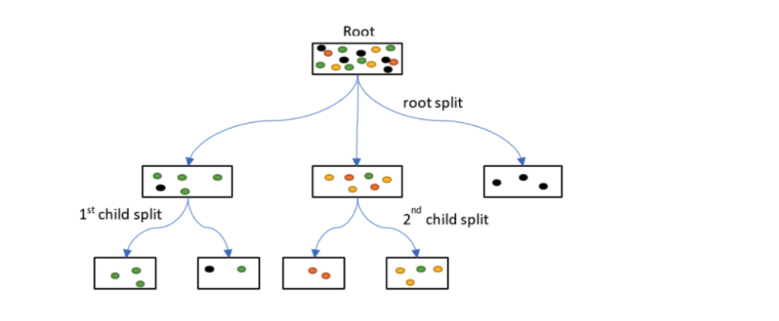
What is the goal of a decision tree?
Goal is to reduce chaos – the “root” node is very chaotic – i.e., many different colors
How do we reduce chaos?
Create groups that are “pure” (composed of one color)
Groups with 2 or more colors are considered “impure”
Is this possible?
Not likely, but we are working towards this goal
Balance between creating “pure” groups vs. “overfitting”

Slide 19
How does the algorithm decide which feature to place in each node?
Three measures
Entropy; information gain; Gini index
Entropy (also referred to as class entropy)
“Measures chaos” – chase
Goal of algorithm is to decrease entropy (i.e., “decrease chaos”)
Information Gain
Measures the reduction of entropy if we add a feature as the condition in each node at a particular depth
Goal of algorithm is to increase information gain (i.e., decrease entropy)
Gini Index
Impurity measure

Slide 20
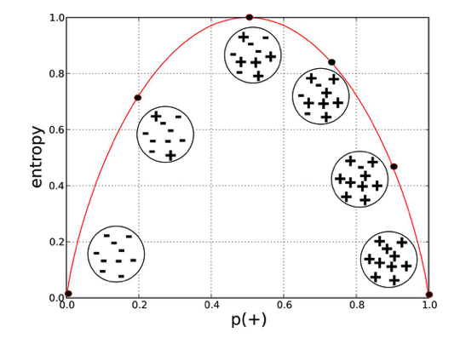
How does the algorithm decide which feature to place in each node?
Entropy (ranges from 0 to 1)
We want entropy to be close to 0, why?
Gini Index (ranges from 0 to 0.5)
We want information smallest value (i.e., less impure)
Information Gain (highest value – i.e., more information gained)

Slide 21
Tie this all together…
https://www.youtube.com/watch?v=ZVR2Way4nwQ

Slide 22
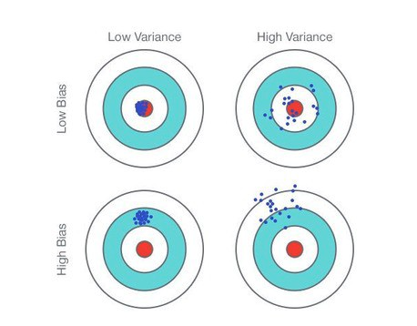
Bias and Variance
Variance – how spread apart?
Bias – how close to the target?

Slide 23
Bias and Variance in ML
Bias is the simplifying assumptions made by a model to make the target function easier to learn.
Low Bias: Fewer assumptions about the form of the Target Function
Decision Trees, k-Nearest Neighbors and Support Vector Machines
High Bias: More assumptions about the form of the target functions
Linear Regression, Linear Discriminant Analysis, and Logistic Regression.
Variance is the amount that the estimate of the target function will change if different training data was used.
Low Variance: Small changes to the estimate of the target function with changes to the training dataset
Linear Regression, Linear Discriminant Analysis, and Logistic Regression.
High Variance: Large changes to the estimate of the target function with changes to the training dataset
Decision Trees, k-Nearest Neighbors and Support Vector Machines

Slide 24
Bias-Variance Tradeoff
The goal of any supervised machine learning algorithm is to achieve low bias and low variance.
In turn, the algorithm should achieve good prediction performance
Parametric or linear machine learning algorithms often have a high bias but a low variance.
Non-parametric or non-linear machine learning algorithms often have low bias but high variance
There is no escaping the relationship between bias and variance in machine learning
Increasing the bias will decrease the variance
Increasing the variance will decrease bias
https://www.youtube.com/watch?v=EuBBz3bI-aA&t=278s

Slide 25
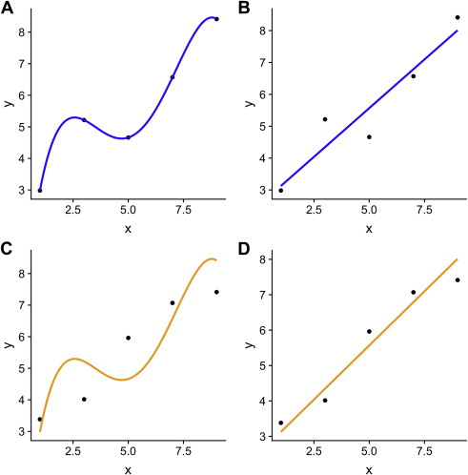
Example

Slide 26
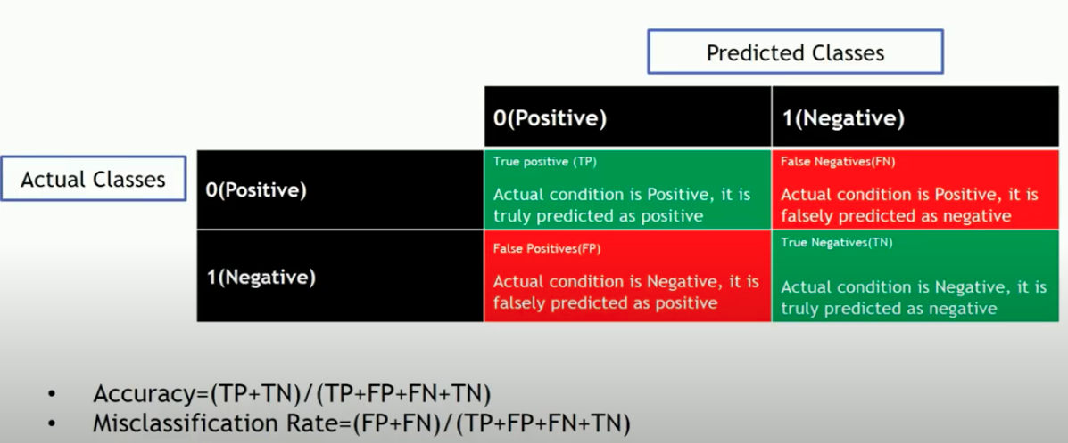
Accuracy
Measure of model performance
https://www.youtube.com/watch?v=YIPsfEtJppE

